Slide 1


CAPSTONE PROJECT
MakeMyTrip Travel Analytics
Dashboard Using Power BI
Presented By
Student Name: Onkar Abhiman Londhe
College Name: s.b. Patil college of Engineering Pune
Department: Computer Engineering
Email ID: onkarlondhe1139@gmail.com

Slide 2
OUTLINE:
Problem Statement (Should not include solution)
Proposed System/Solution
System Development Approach (Technology Used)
Algorithm & Deployment
Result (Output Image)
Conclusion
Future Scope
References

Slide 3
Problem Statement:
The travel industry generates a huge amount of booking data every day. However, raw data stored in spreadsheets or databases is difficult to analyze quickly.
Difficulty in tracking total bookings and revenue
Lack of clear insights into popular destinations
Travel companies face the following problems:
Hard to analyze customer demographics and travel patterns
No centralized platform to visualize airline performance and booking channels
Decision makers need quick and interactive insights for better business strategies.
Therefore, a data visualization system is required to convert complex travel data into meaningful insights.

Slide 4
Proposed Solution:
The proposed system is a Travel Analytics Dashboard built using Microsoft Power BI.
The system collects travel booking data and converts it into interactive visual reports.
Key features of the system include:
Visualization of Total Bookings, Revenue, and Average Booking Value
Analysis of Top Travel Destinations
Identification of Most Used Airlines
Visualization of Traveler Demographics
Tracking of Monthly Booking Trends
Geographic visualization of bookings through India Heatmap
Interactive filters such as Date Range, Destination, and Traveler Type
This dashboard helps business managers quickly understand travel trends and make data-driven decisions.

Slide 5
System Approach:
The system is developed using the following technologies:
1. Data Source
CSV dataset containing travel booking information
2. Data Processing Tool
Microsoft Power BI Desktop
3. Data Fields Used
Booking ID
Booking Date
Destination
State
Airline
Traveler Type
Booking Channel
Booking Value
Customer Rating
4. Visualization Components
KPI Cards
Line Charts
Bar Charts
Pie Charts
Map Visualization
Slicers (Filters)

Slide 6
Algorithm & Deployment:
The development of the dashboard follows these steps:
Step 1 – Data Collection Generate or collect travel booking dataset.
Step 2 – Data Import Import the dataset into Power BI.
Step 3 – Data Cleaning Use Power Query to remove errors, duplicates, and format data.
Step 4 – Data Modeling Create relationships and calculated measures such as:
Total Bookings
Total Revenue
Average Booking Value
Step 5 – Visualization Design Create dashboard visuals such as:
Booking Trend Chart
Top Destinations Chart
Traveler Demographics Pie Chart
India Booking Heatmap
Top Airlines Chart
Step 6 – Deployment Publish the dashboard for users to analyze travel business performance.

Slide 7
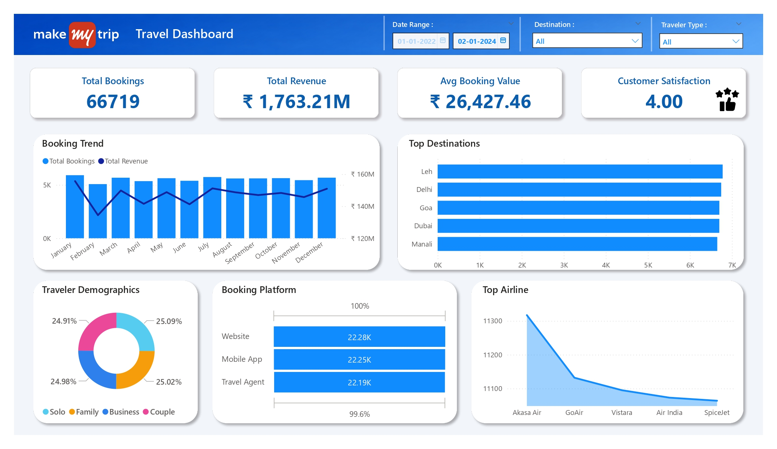
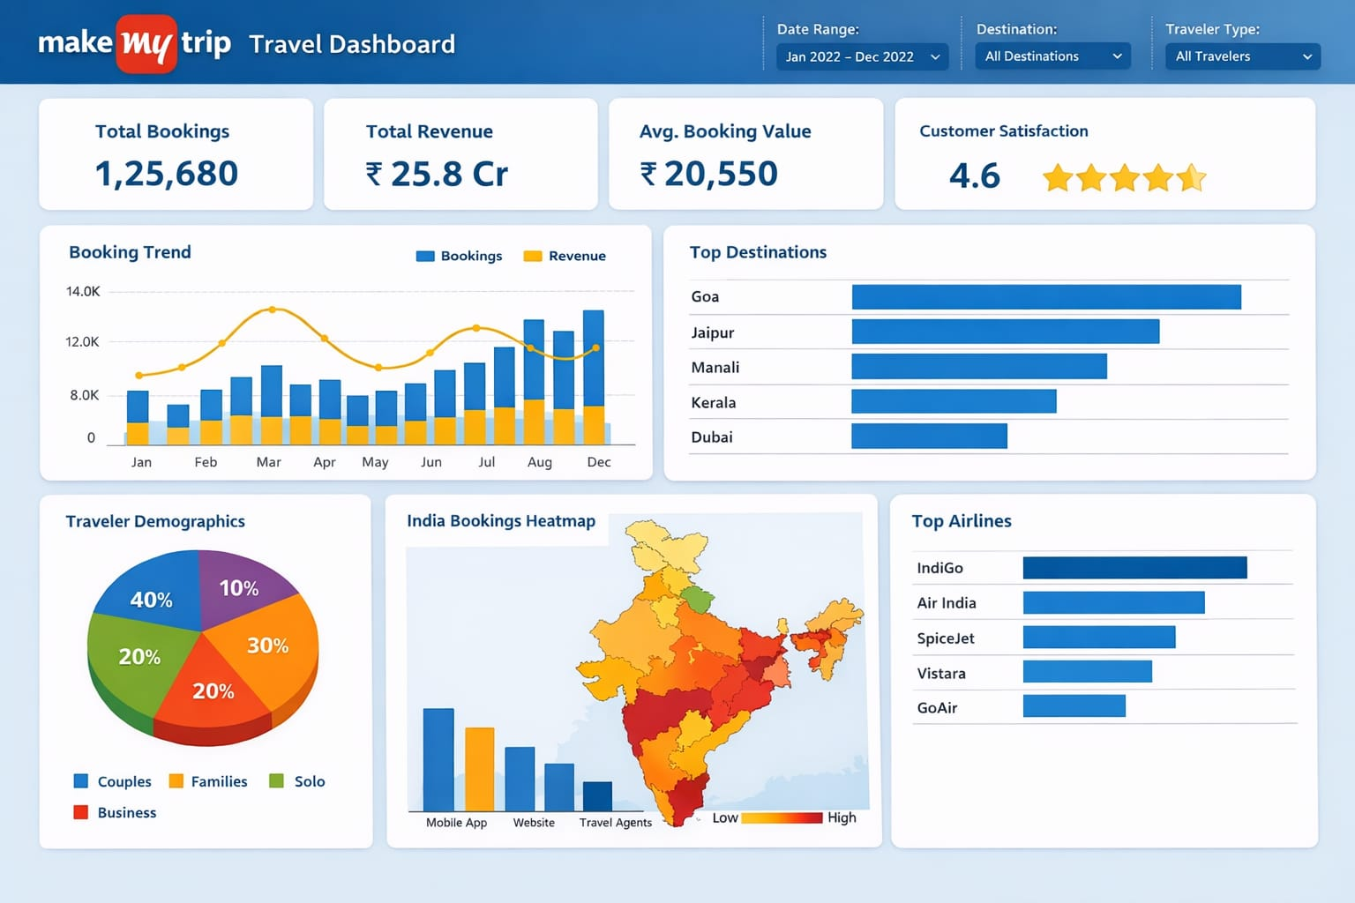
Result:

Slide 8
Conclusion:
The MakeMyTrip Travel Analytics Dashboard provides a powerful way to analyze travel booking data.
The system converts large amounts of raw data into clear visual insights.
Benefits of the system include:
Improved business decision making
Easy monitoring of booking trends
Identification of popular destinations and airlines
Better understanding of customer travel behavior
Power BI makes it possible to analyze big datasets efficiently through interactive dashboards.

Slide 9
Future scope:
The system can be further improved by adding the following features:
Integration with real-time travel booking systems
Implementation of machine learning for demand prediction
Addition of hotel and holiday package analytics
Mobile dashboard access through Power BI Service
Integration with cloud platforms like AWS or Azure

Slide 10
References:
Microsoft Power BI Documentation
Microsoft Learn – Power BI Tutorials
MakeMyTrip Travel Industry Reports
Data Visualization Best Practices
Online resources for Power BI Dashboard Development
GitHub Link: OnkarLondhe-MS-Elevate-AICTE-Internship---Power-BI-Project---Feb-2026

Slide 11
Thank You

